Slide 1
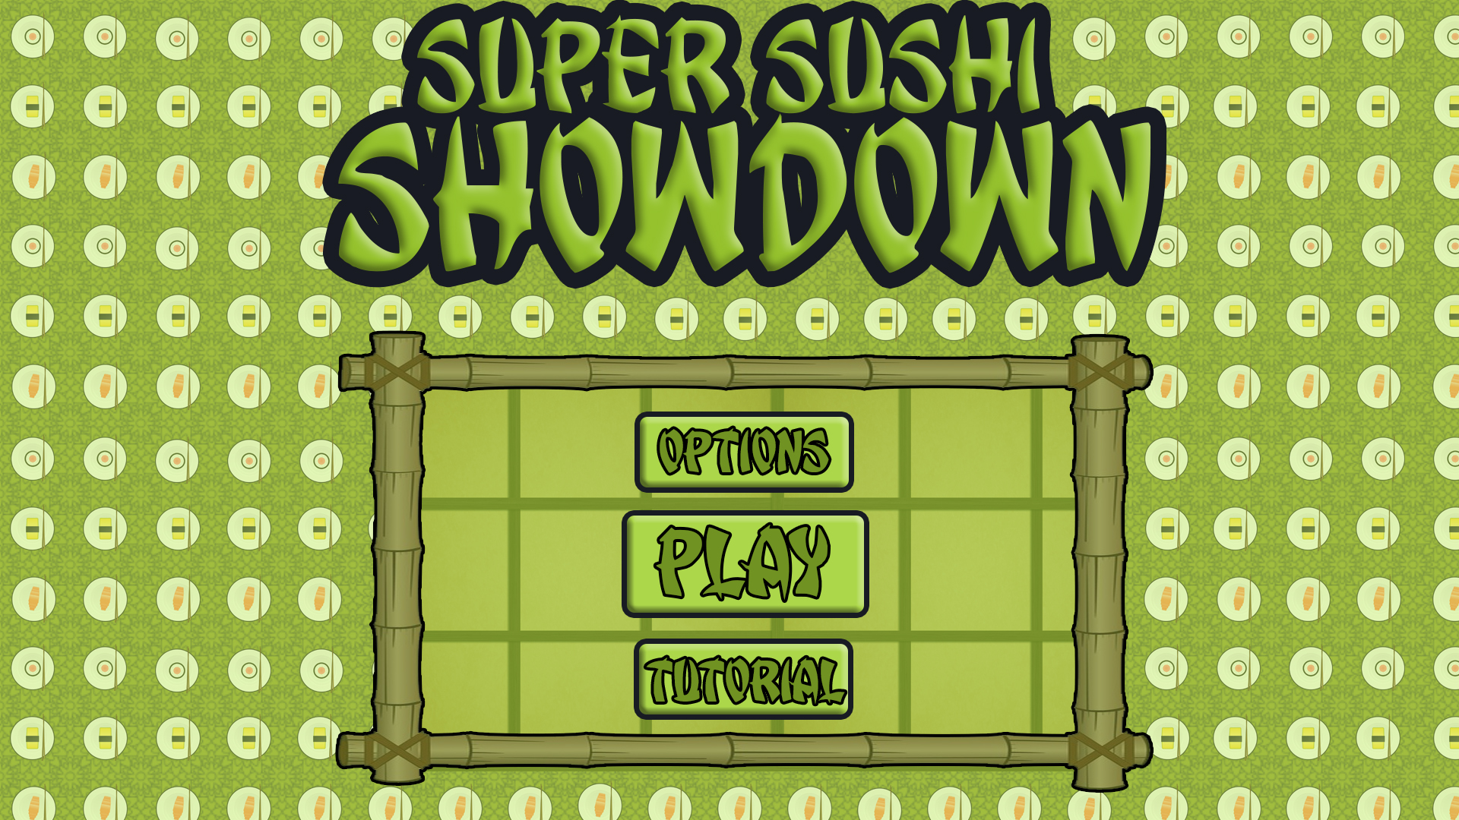
Level 4/5 – Group 5
Bandi Namco Fourth Pitch
Henry Crofts, Ashley Long, Samuel McMillan and Dawid Hojka

Slide 2
Latest version

Slide 3
Overview
How the game fits the brief
What emotions we were going for
Amusement
Schadenfreude
What emotions we managed to achieve
Amusement
Fiero

Slide 4

Playtesting video

Slide 5
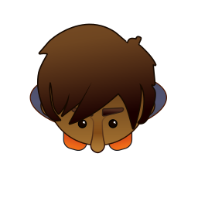



What are players struggling with
Score values – Customers unclear
Players thought they could tap anywhere to hit node
Could tap phone on other players turn in order to cheat

Slide 6




What do players enjoy
Enjoyed feedback pop ups
Sense of fiero
Art styles

Slide 7


Changes from player feedback
Not sure what score is.
Changed scale of game.
Added feedback pop ups.

Slide 8
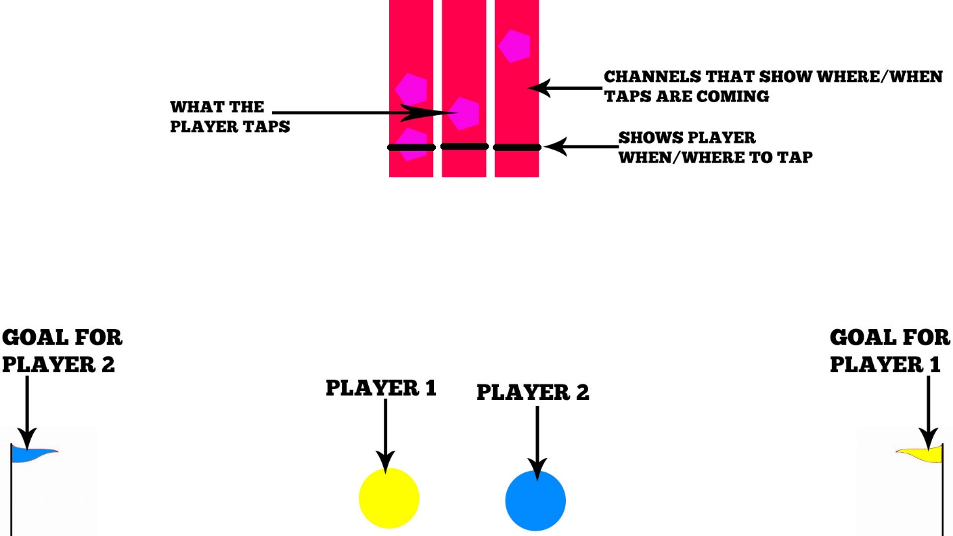
Changes from player feedback
Players thought sushi moved too slow.
Players felt like they were
playing separate games
Balance of game

Slide 9



Design lessons learnt
Balancing
Feedback loops
Importance of playtesting
Importance of consistency
UI Designs

Slide 10
Programming lessons learnt
Reusable code
Naming conventions
Know your limits

Slide 11
Management lessons learnt
Meetings
Game Jams
Communication
Attendance

Slide 12
Questions?

